Slide 1

Early Breast Cancer Detection: A Data Mining Approach
CSE 572: Data Mining
Prof. Yanjie Fu
Amit Ashok Manjarly
Aditya Deshpande

Slide 2
01
Introduction
02
Initial EDA
Table of Contents
03
Data Pre-processing
04
Initial Model Training
05
Check point 2
06
Conclusion and Future Plan

Slide 3
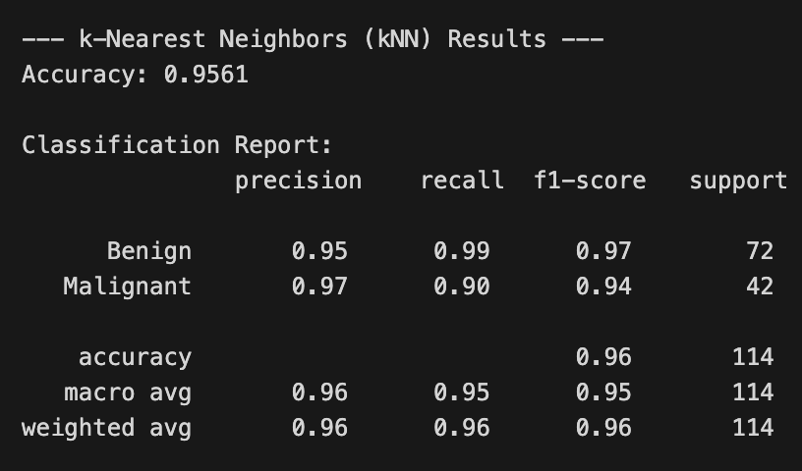
01 Introduction
Initial Dataset: The Wisconsin Diagnostic Breast Cancer (WDBC)
WDBC Overview
A well-known, clean dataset initially considered for its simplicity; it serves as good starting point for breast cancer detection modeling.
The "Good Problem": Overly Clean Data
High accuracy (95-97%) with baseline models due to the data's inherent simplicity; challenges the project's learning objectives.

Slide 4
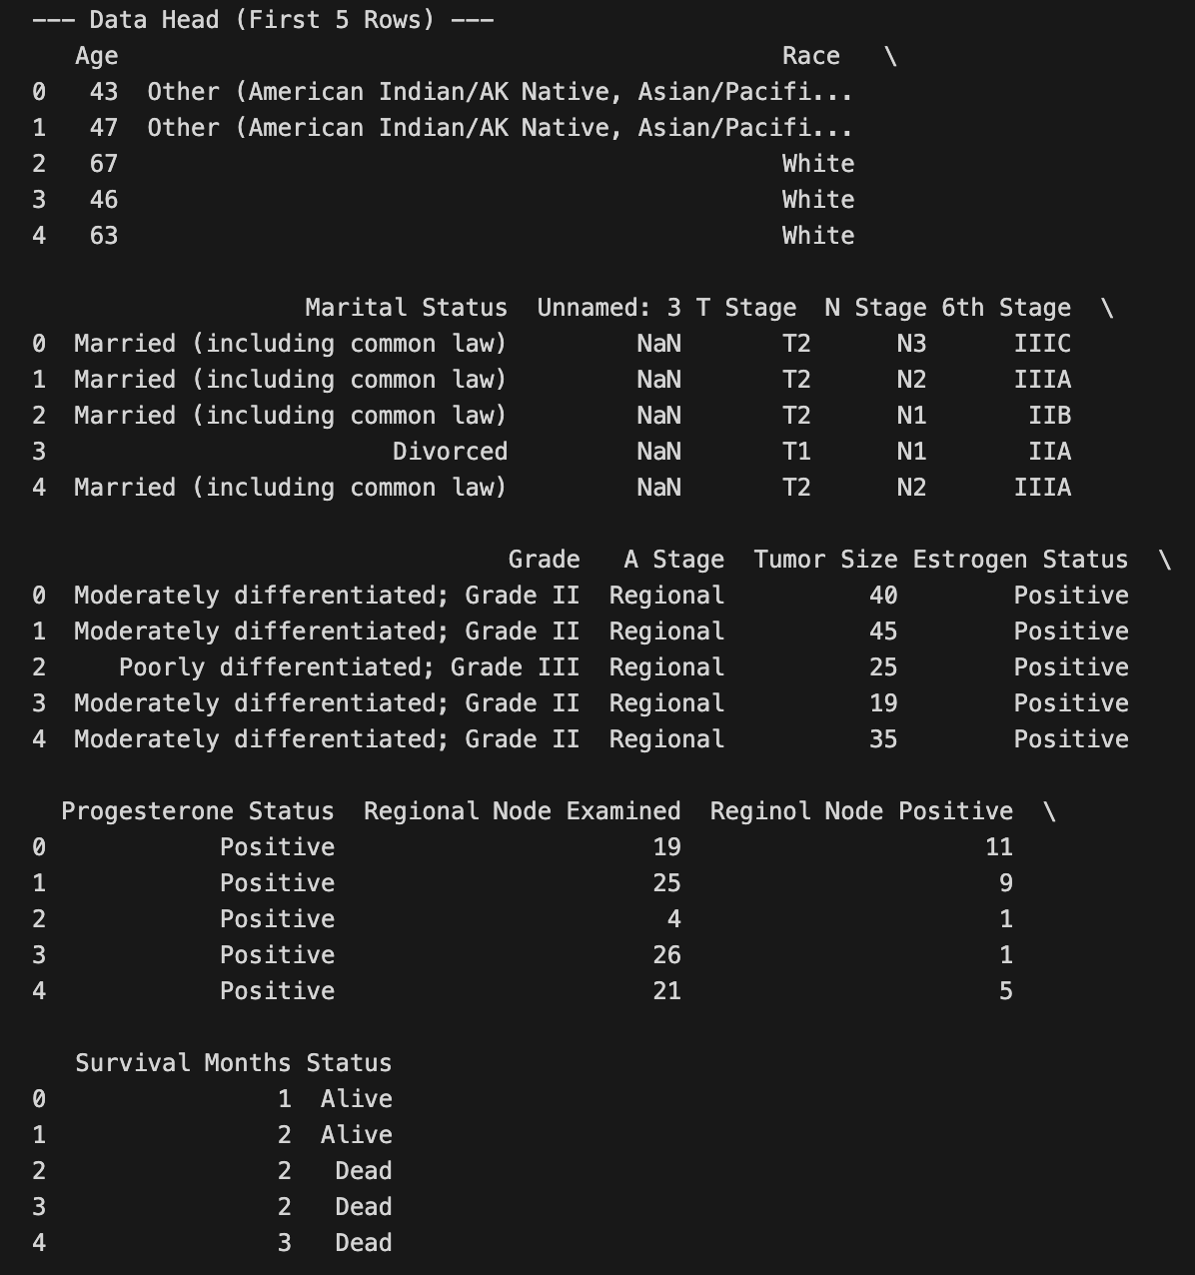
The Solution: Surveillance, Epidemiology, and End Results (SEER) Dataset
01
SEER Overview
A larger, more complex dataset providing real-world challenges; SEER offers a mix of numerical and categorical data.
02
Real-World Data Mining Challenges
Missing values, class imbalance, and complex data types offer opportunities; SEER offers a better representation of reality for modeling.

Slide 5
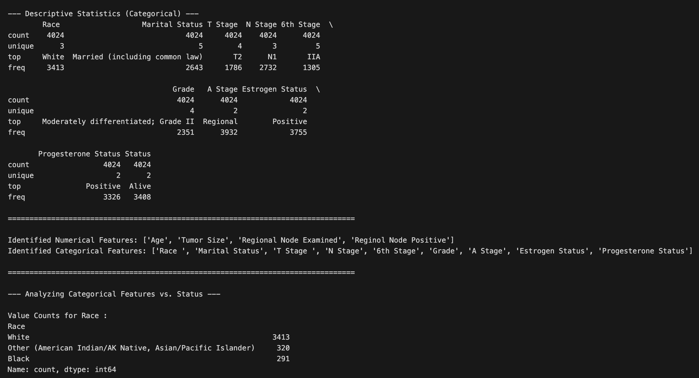
02 Initial EDA
Initial Data Inspection
Dataset Size and Structure
Over 4,000 patient records with 16 columns; SEER offers the appropriate scope and scale for meaningful modeling.
Data Types
Mix of int64 (numerical) and object (categorical) data types; requires careful preprocessing to prepare for analysis.

Slide 6
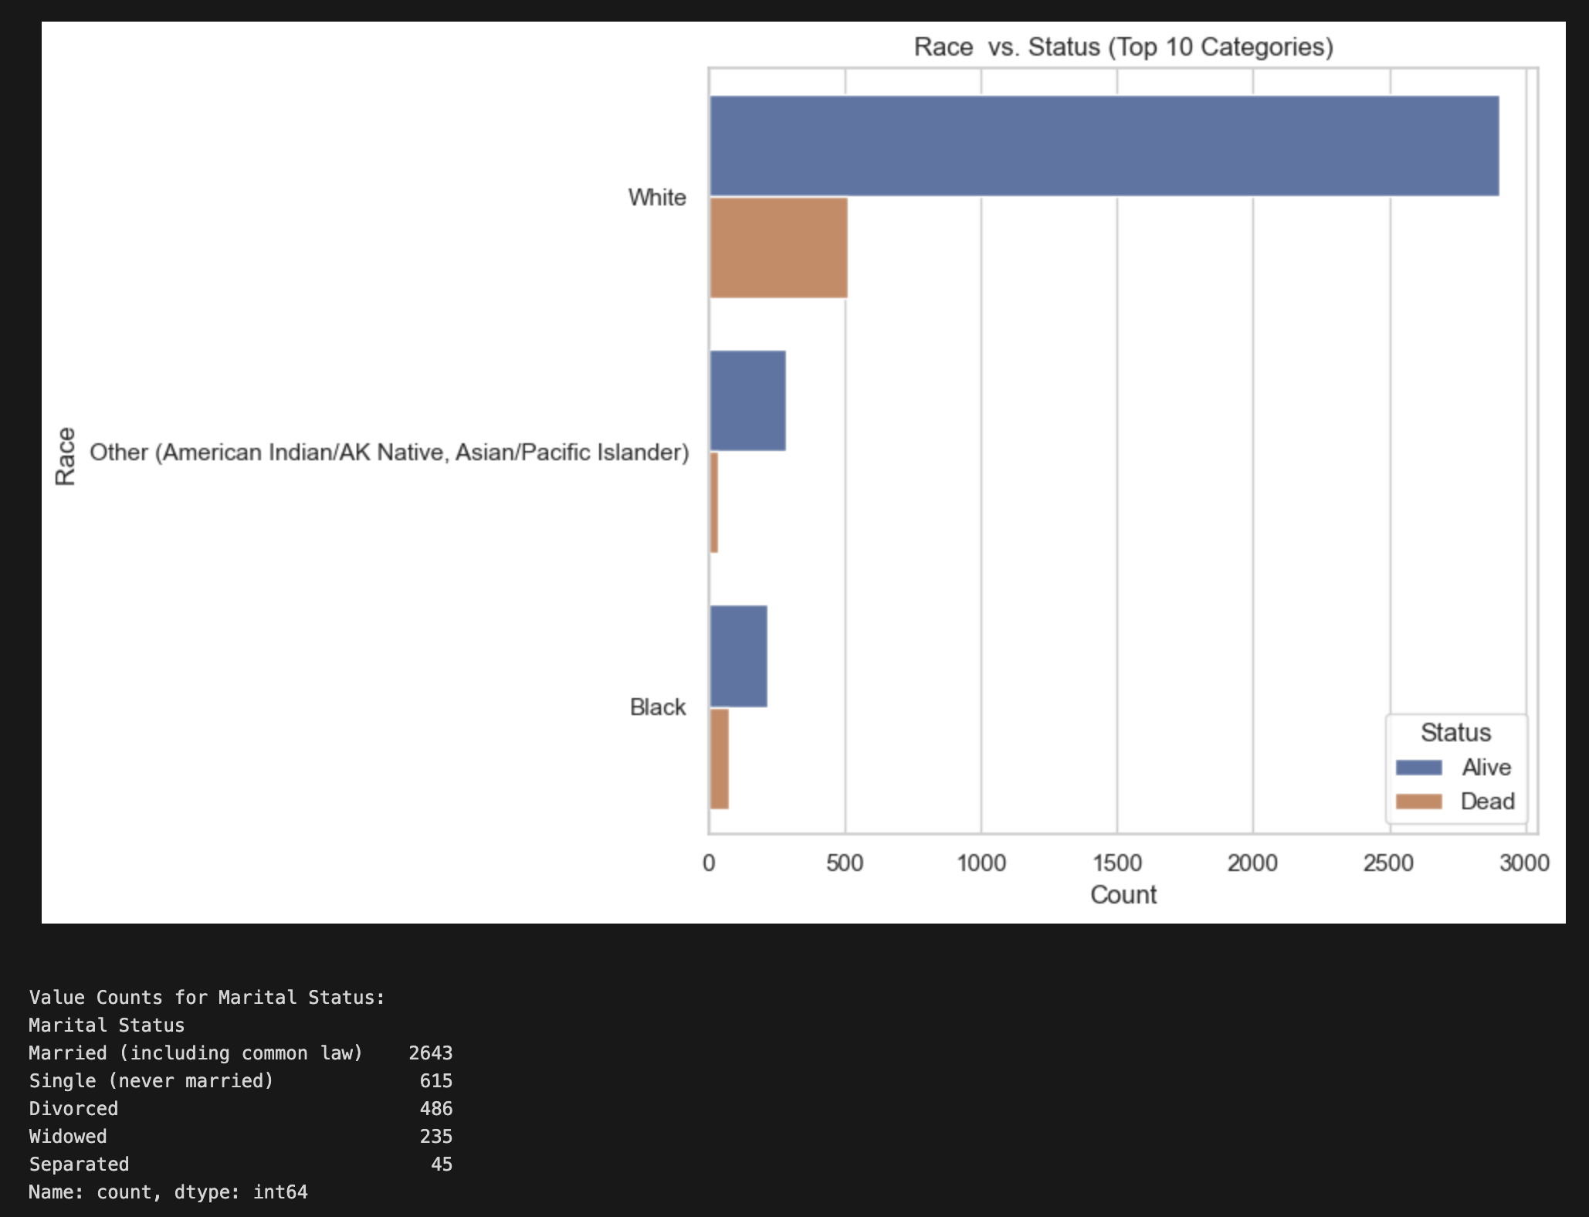
Target Variable Analysis: Status
Distribution of "Alive" vs. "Dead"
Significant class imbalance: 85% "Alive," 15% "Dead"; reveals challenges the modeling must overcome.
Implications of Class Imbalance
Accuracy as a misleading metric; emphasizes the need to correctly identify the minority class "Dead."

Slide 7
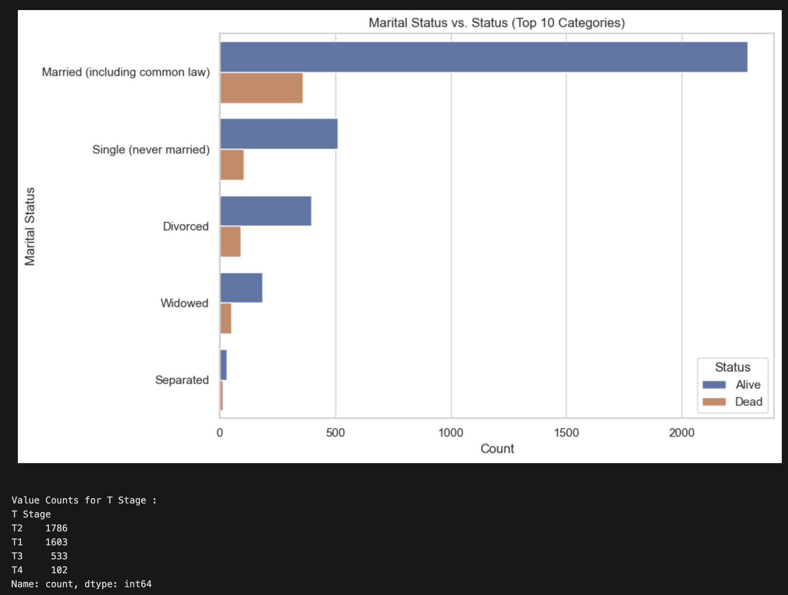
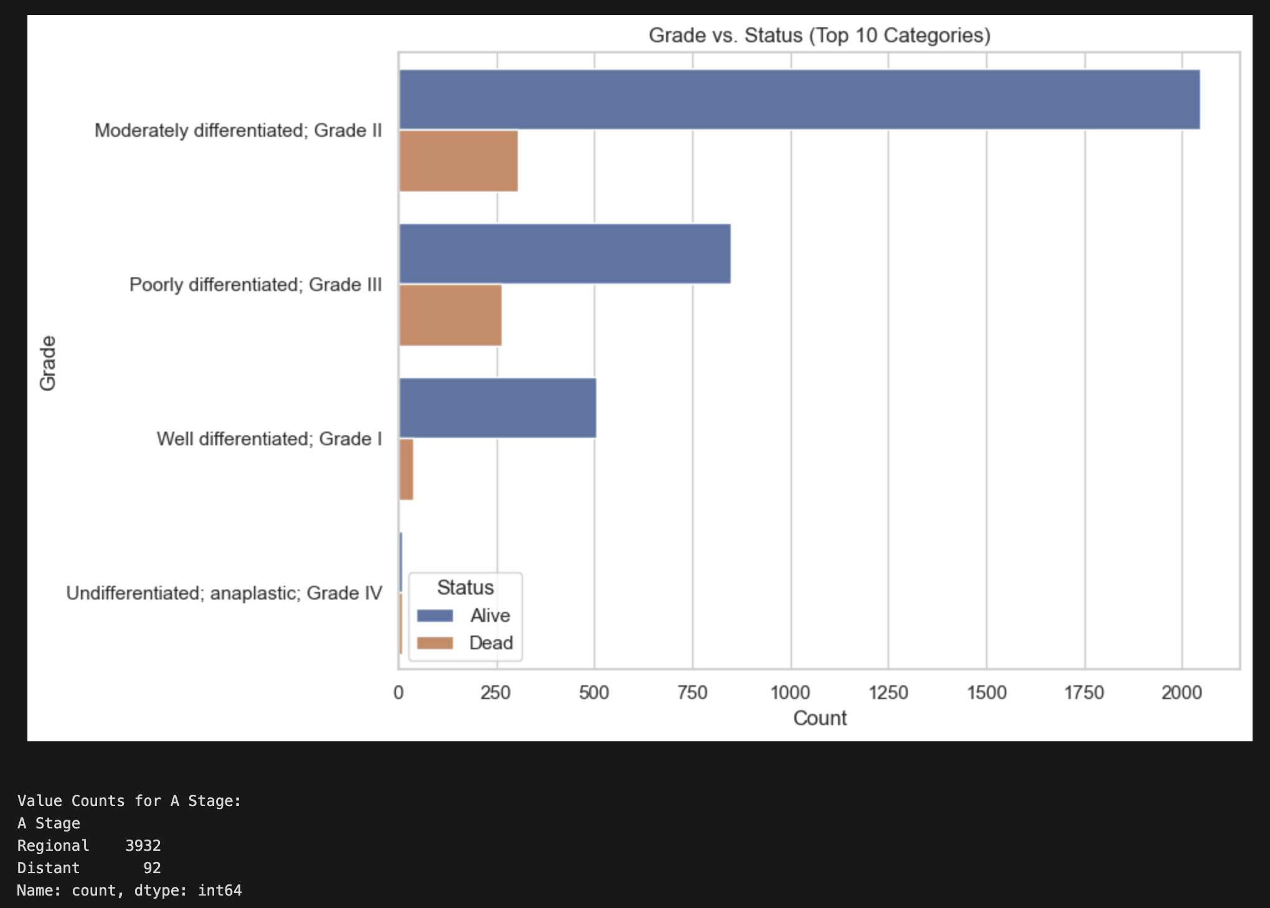
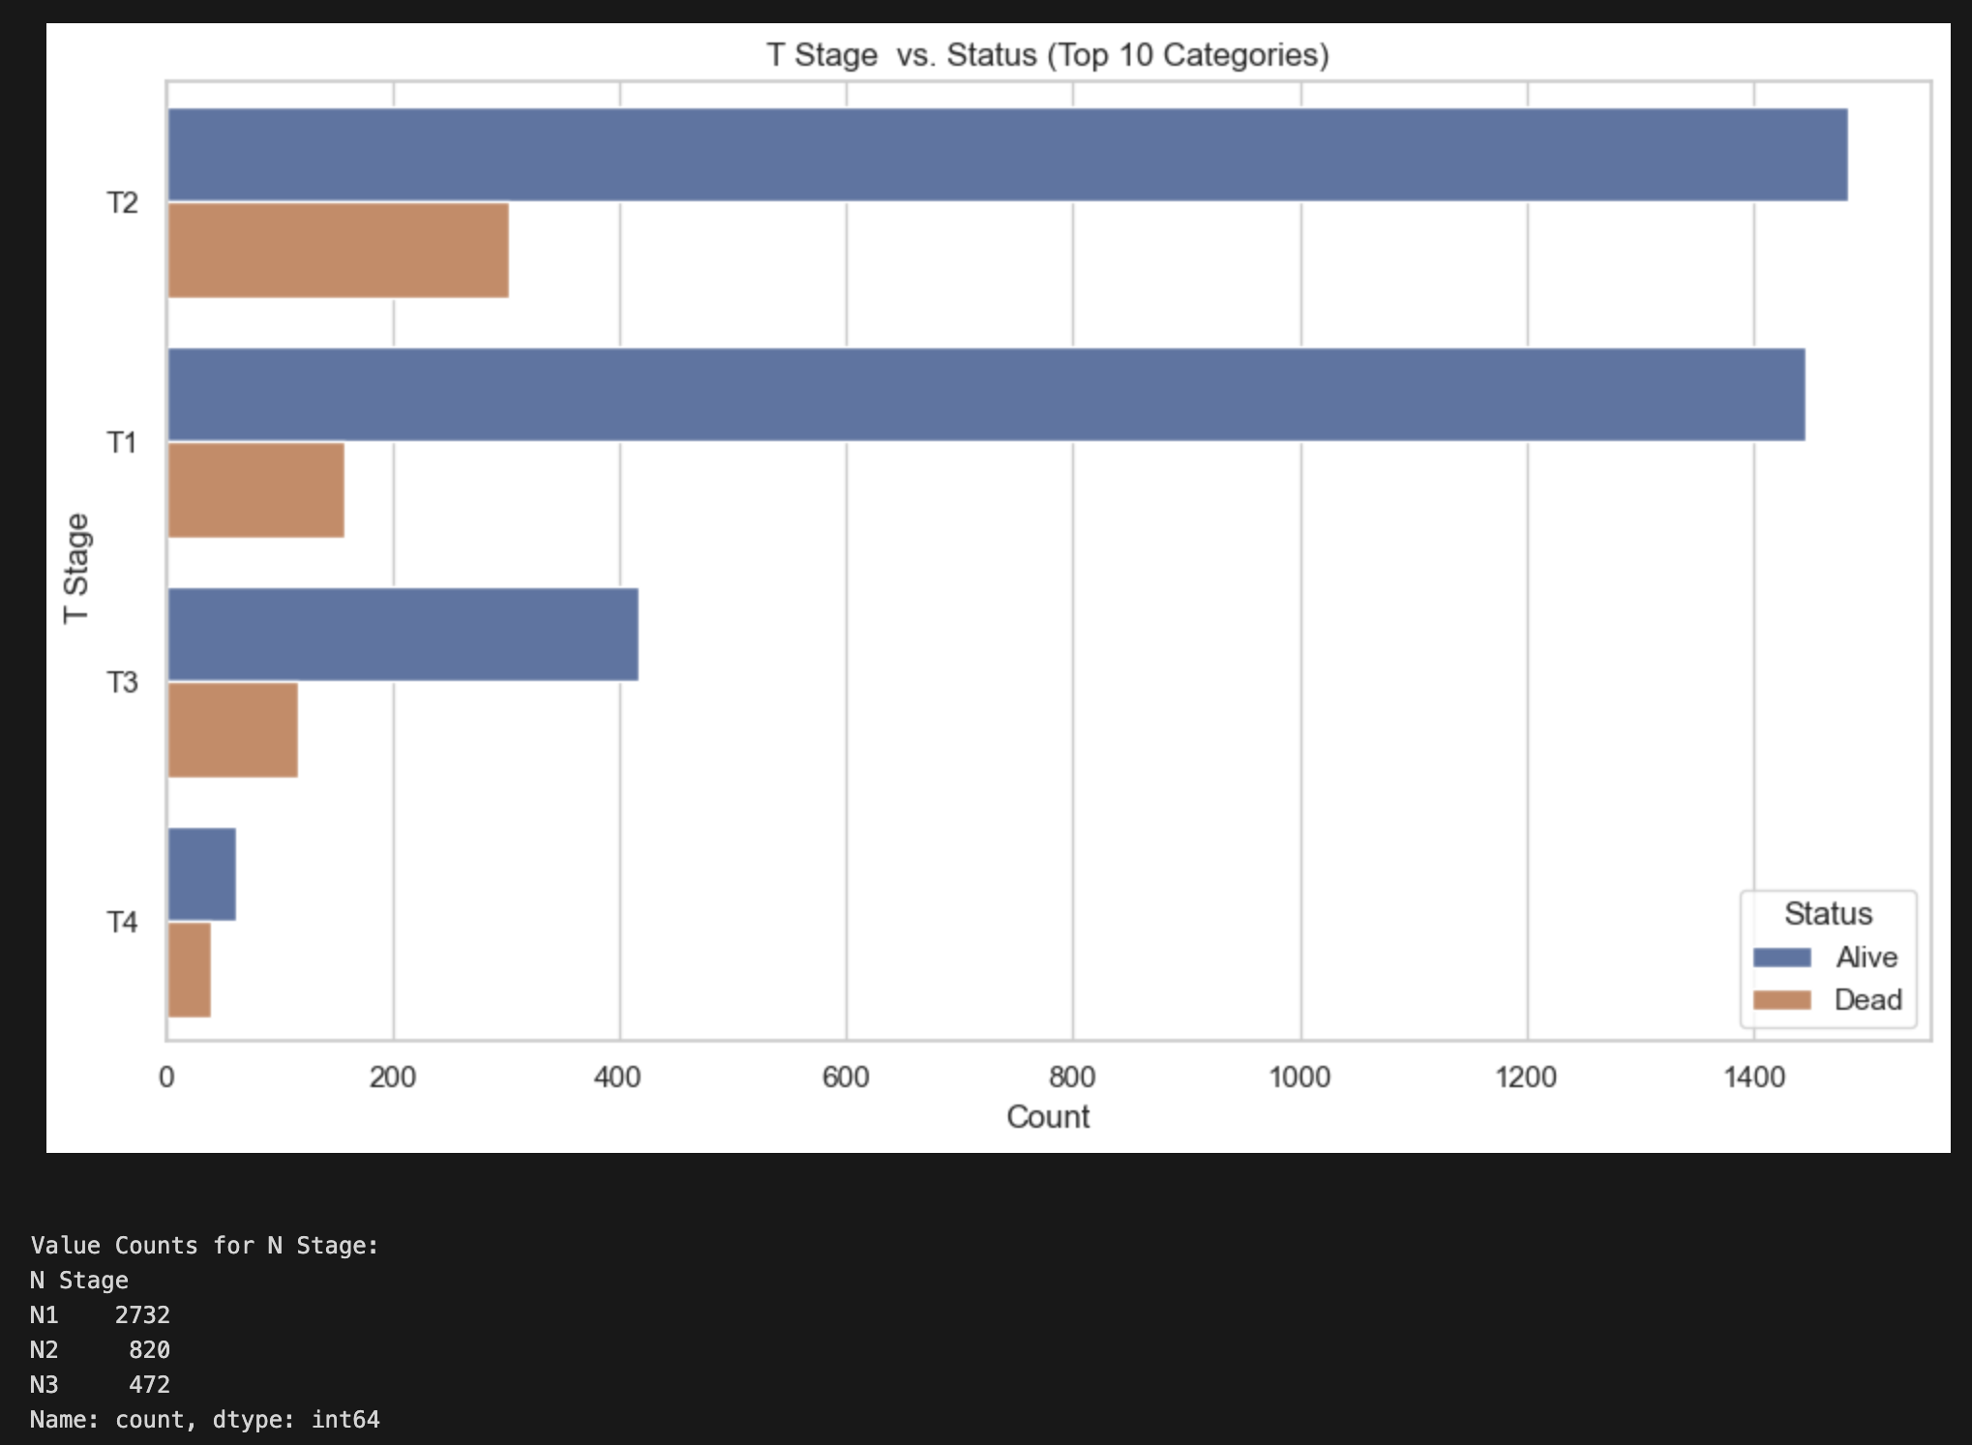
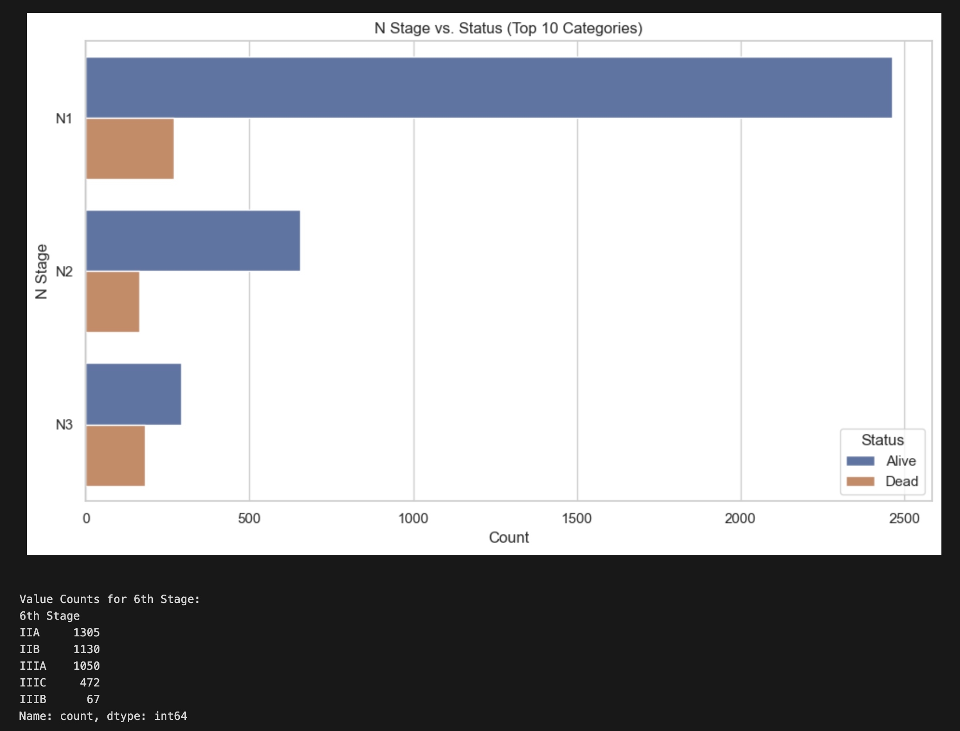
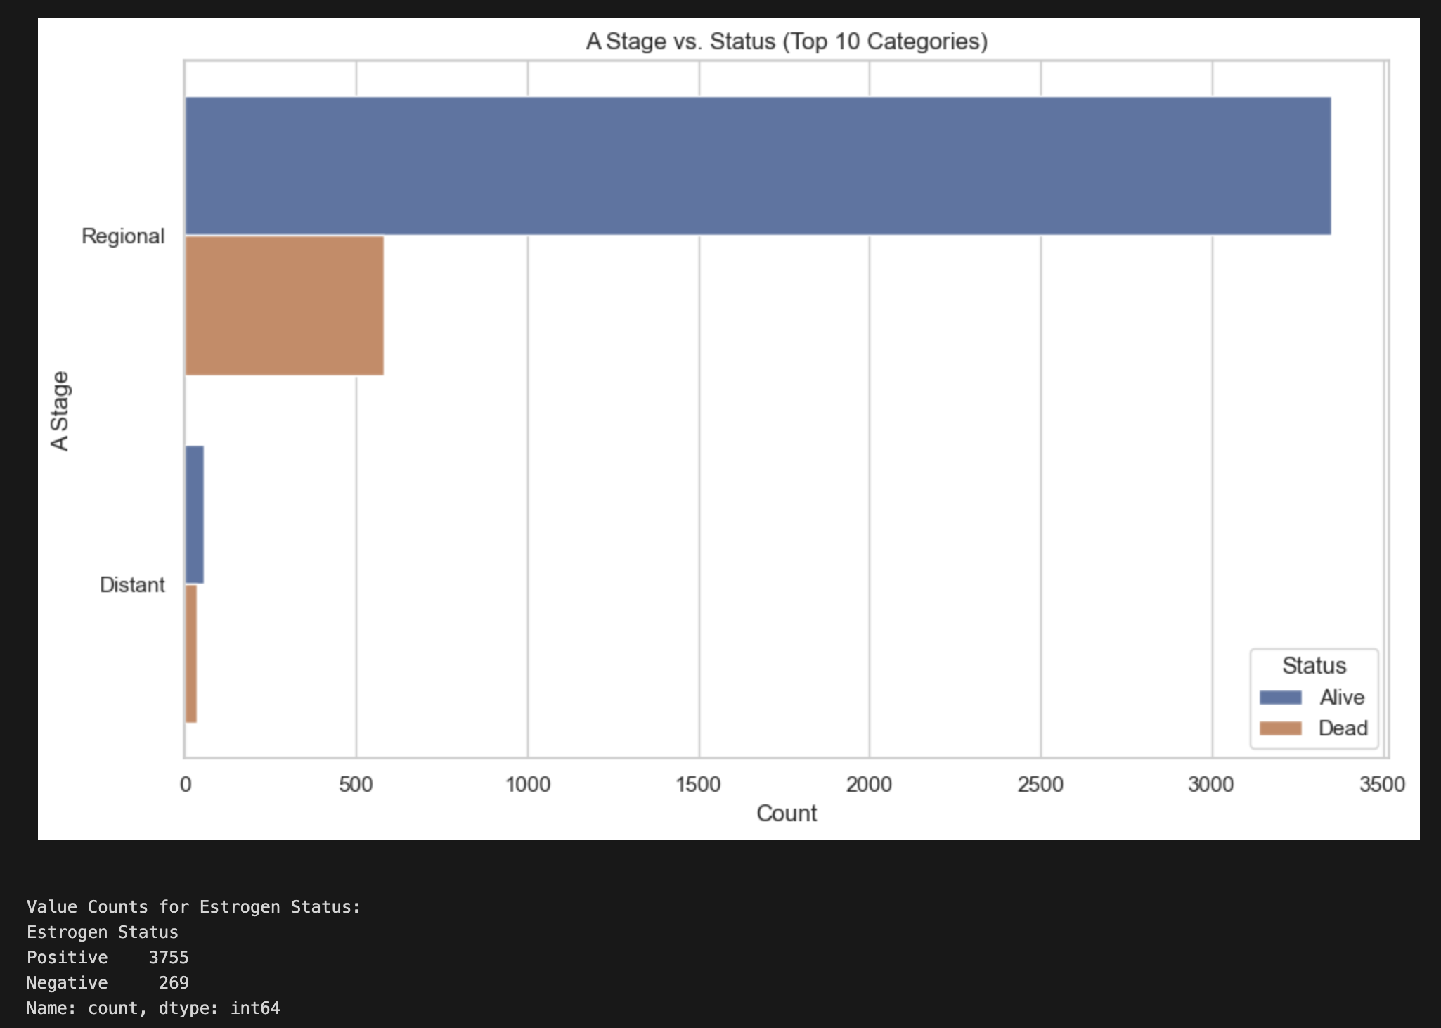
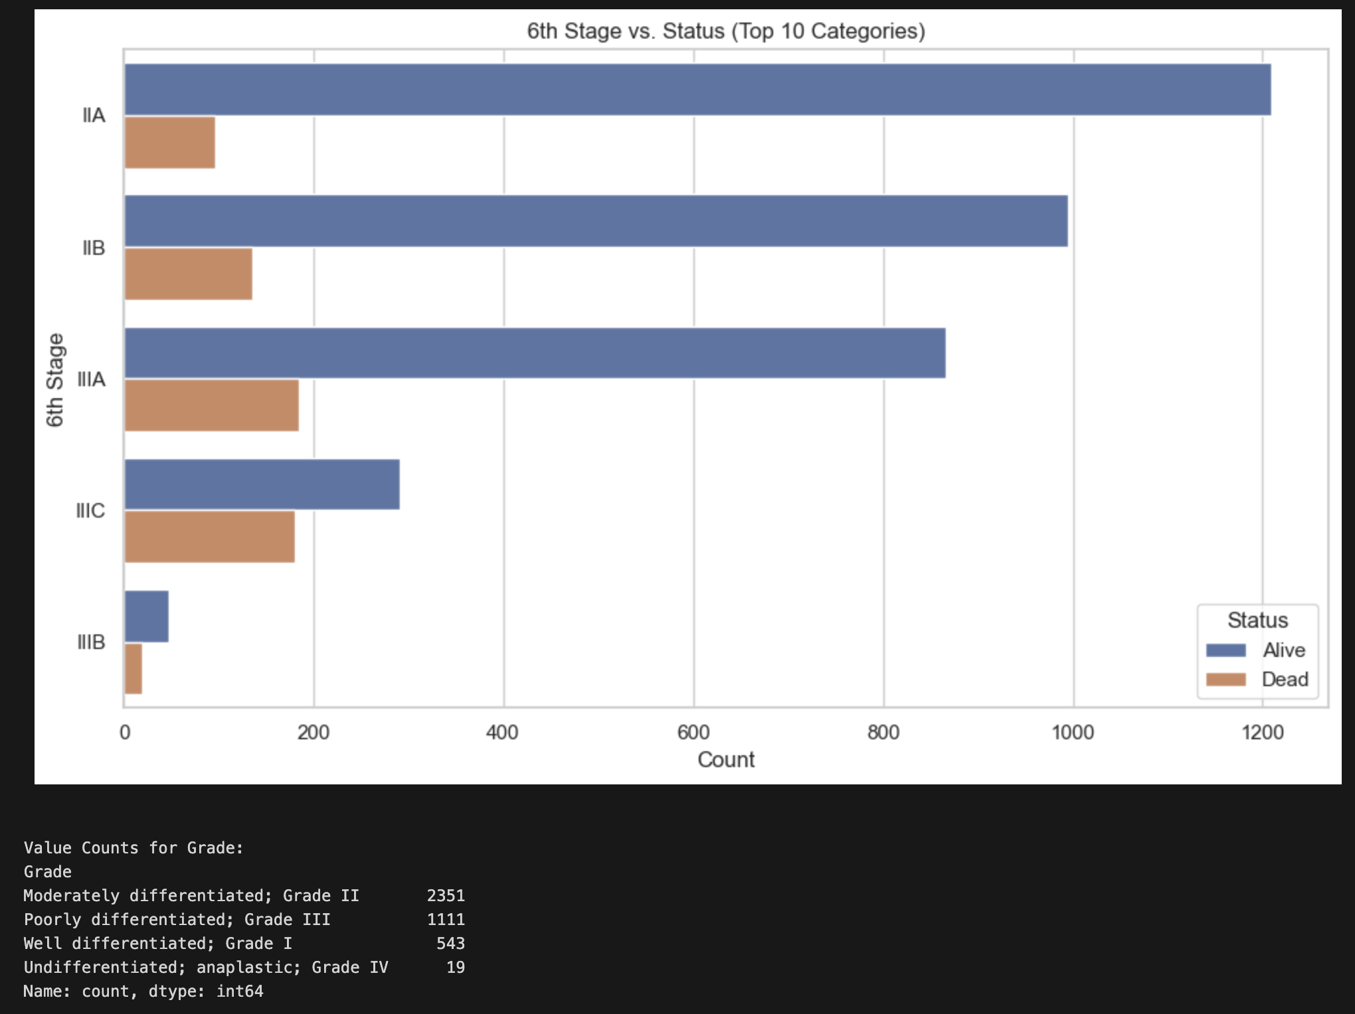
”Alive” vs “Dead” Comparison

Slide 8
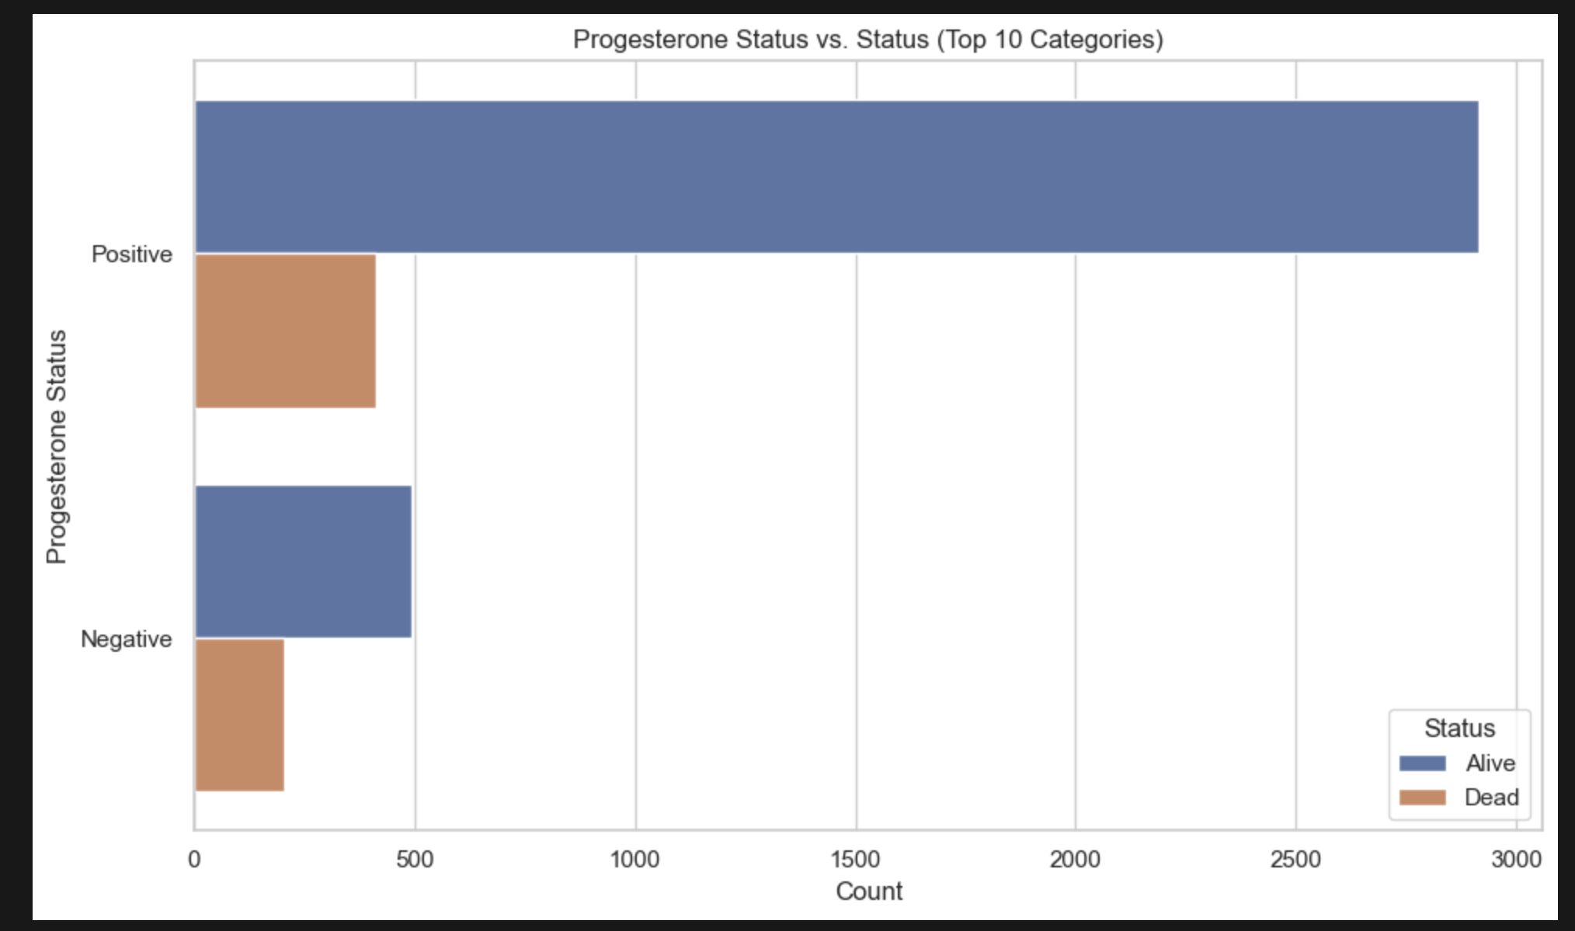
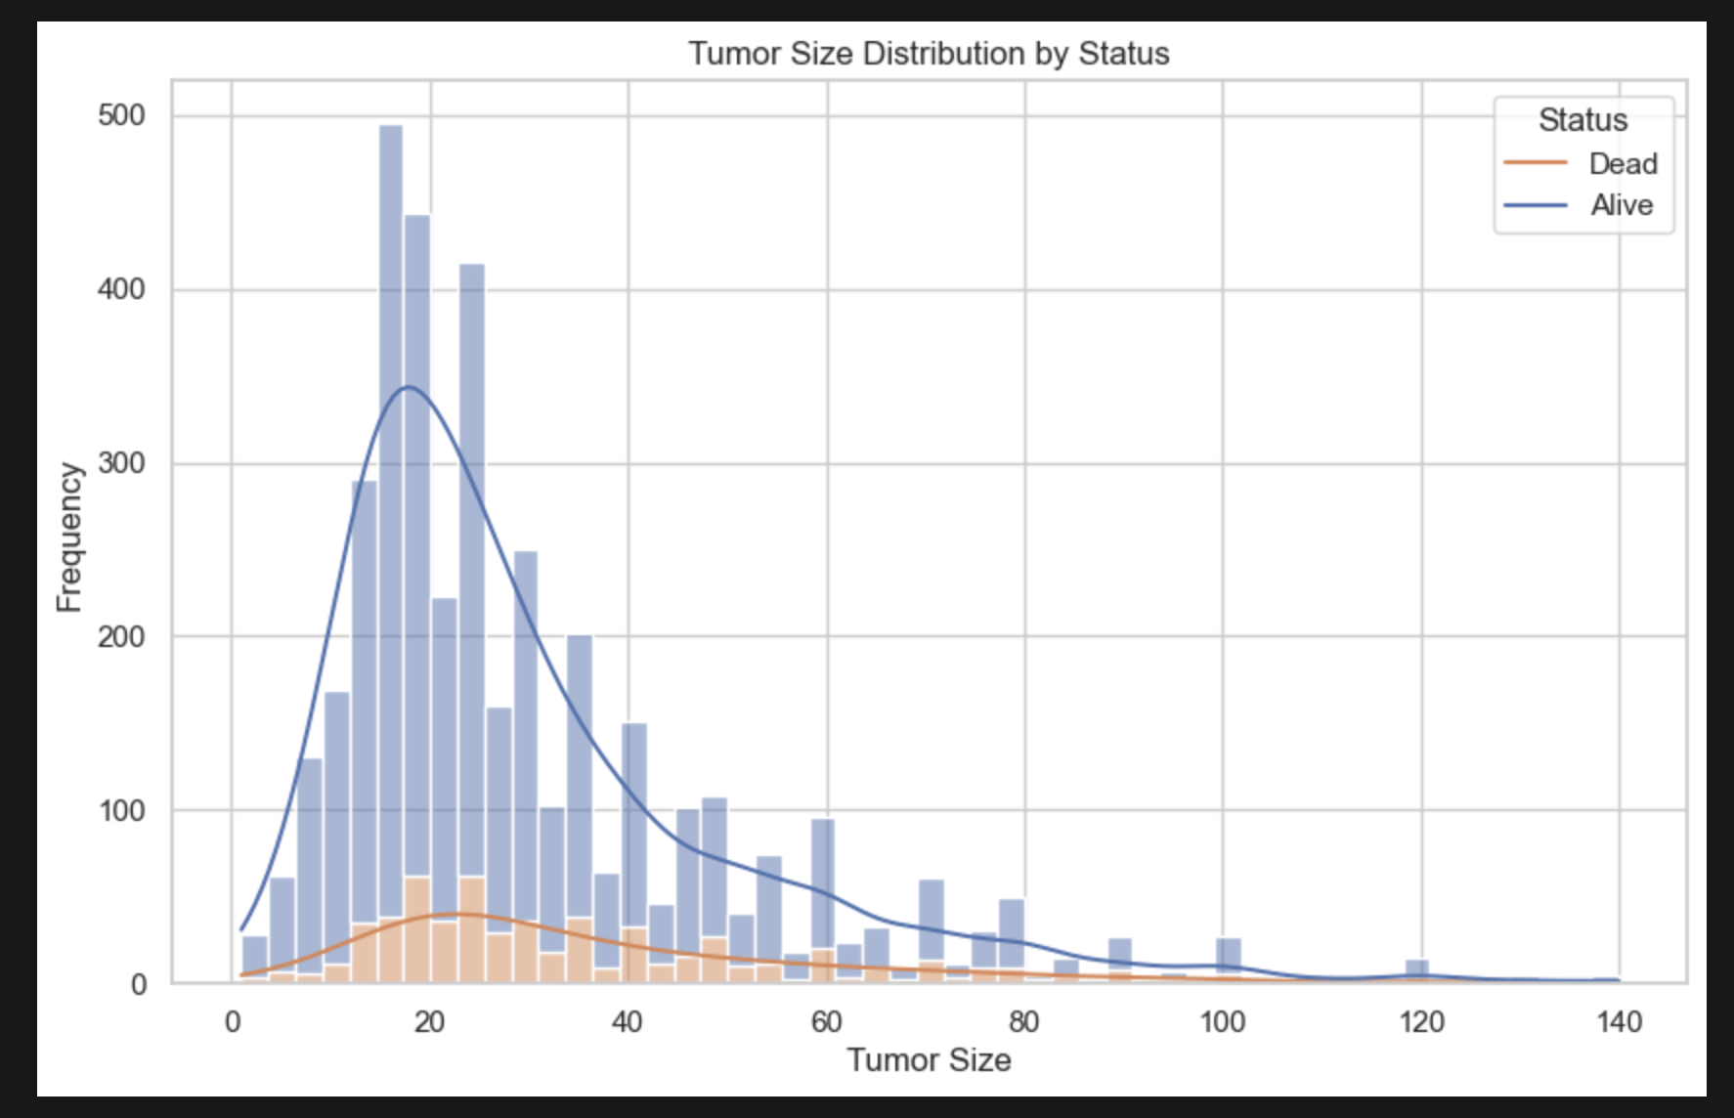
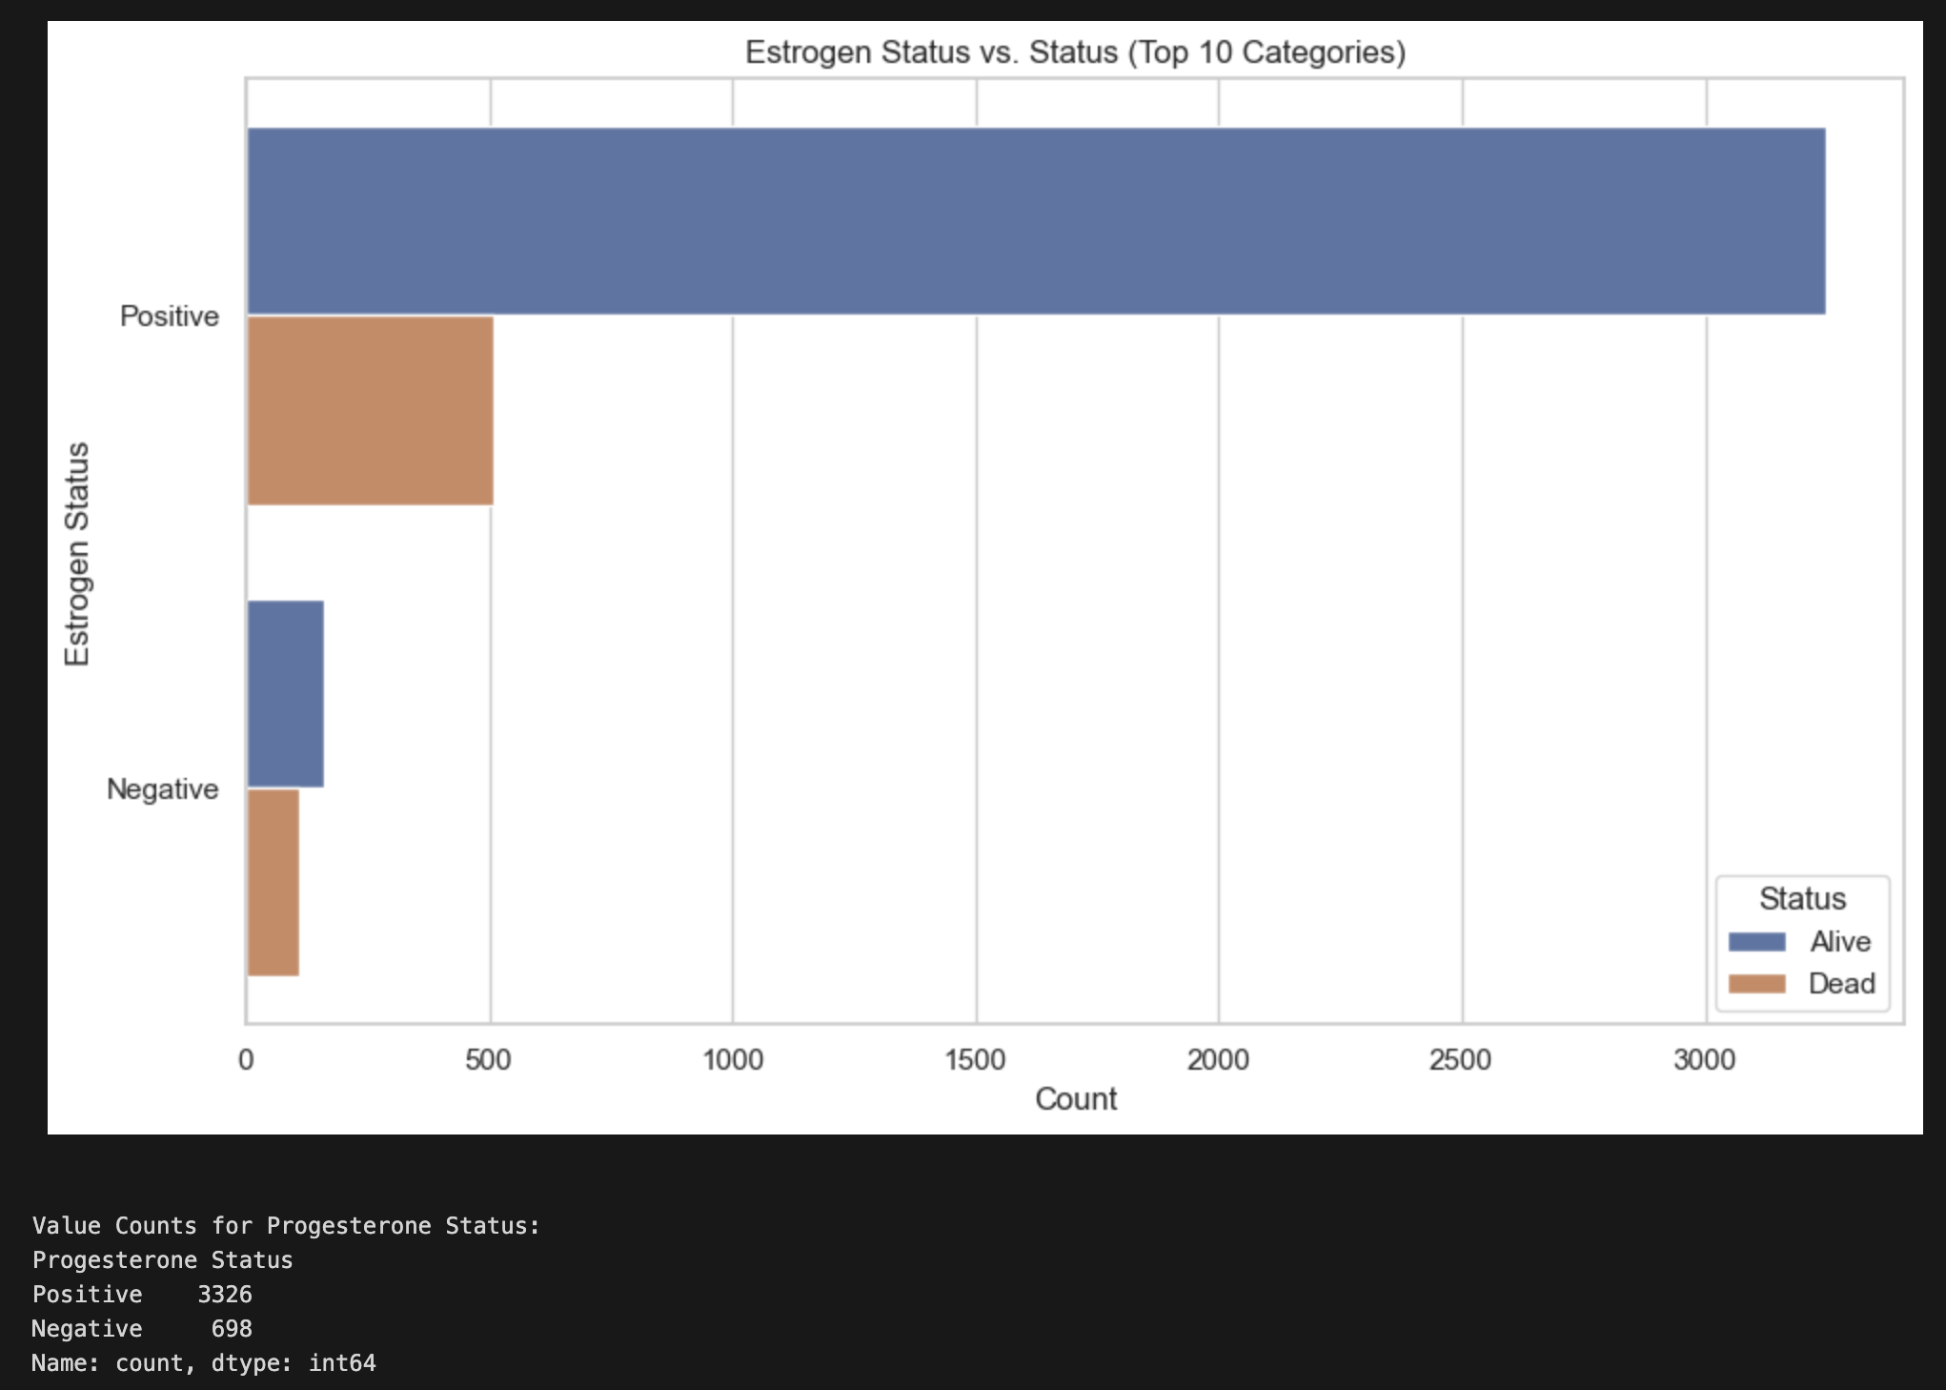
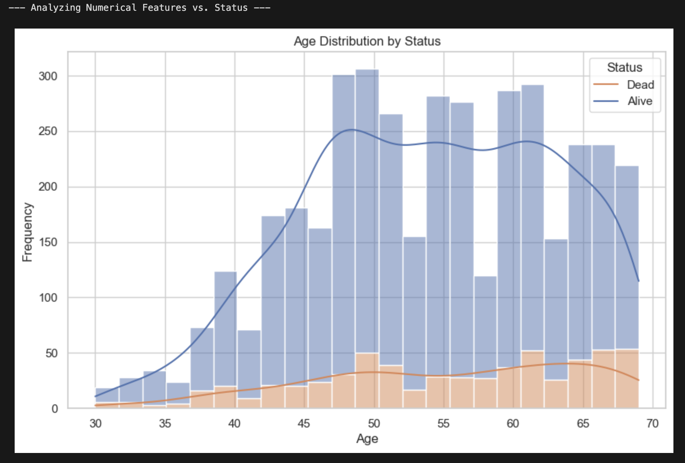
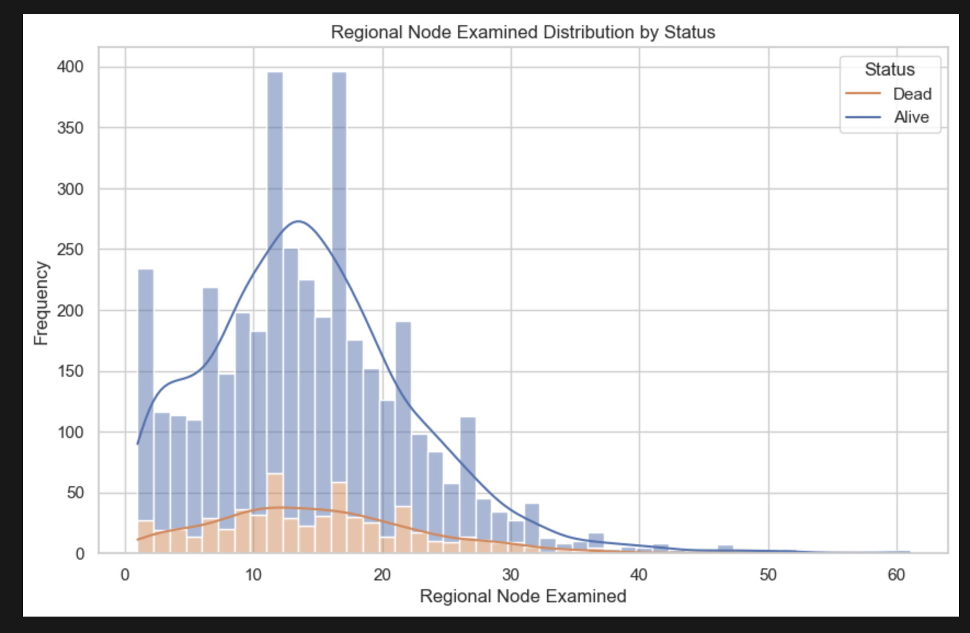
”Alive” vs “Dead” Comparison

Slide 9
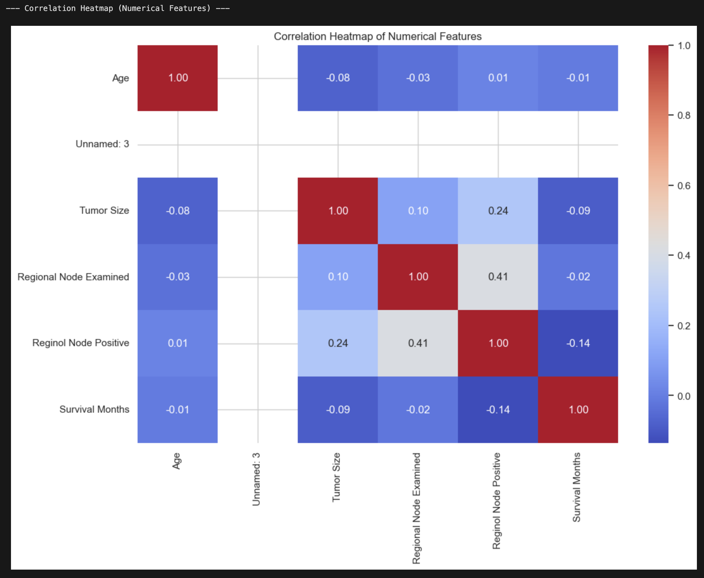
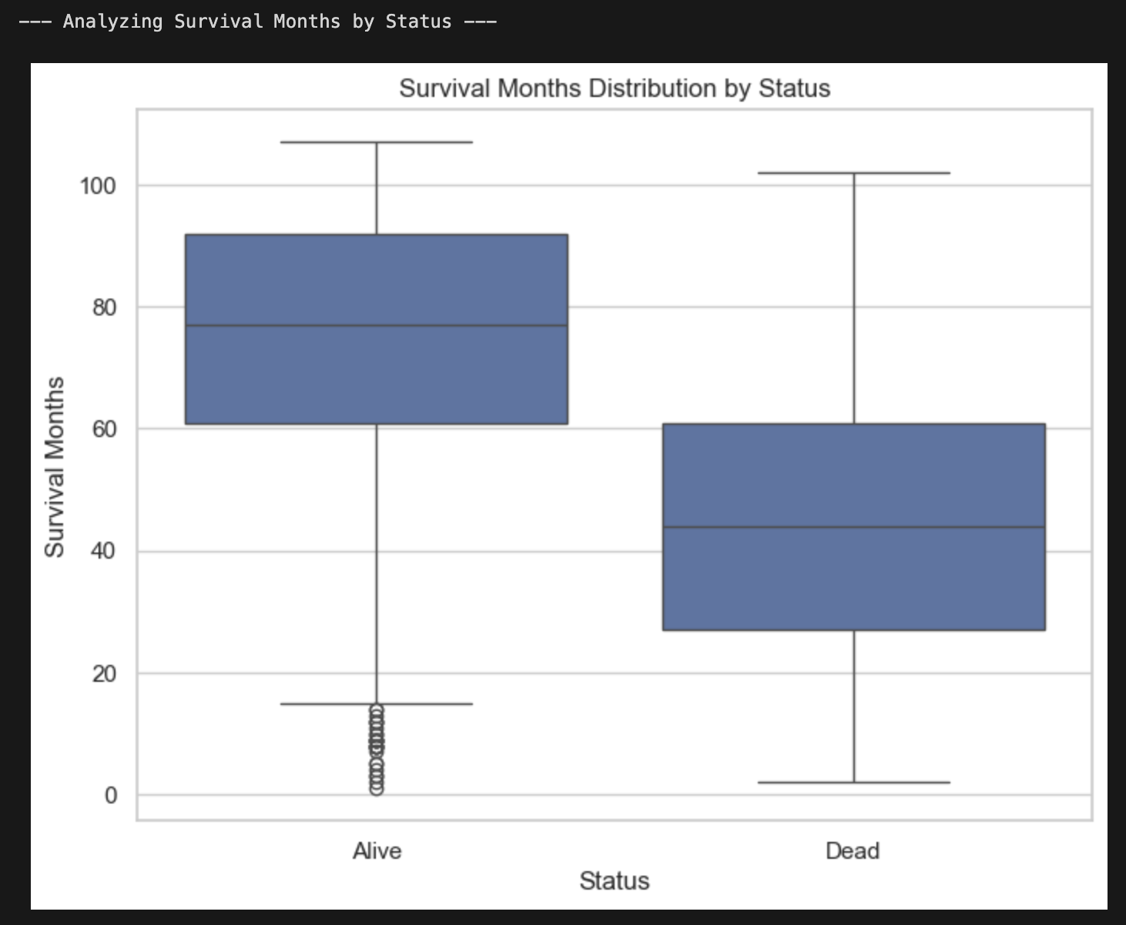

Slide 10
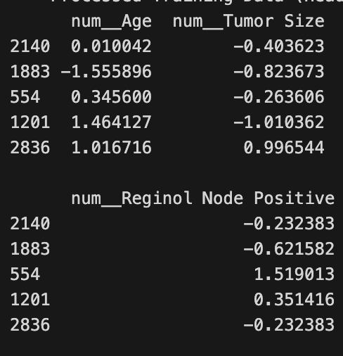
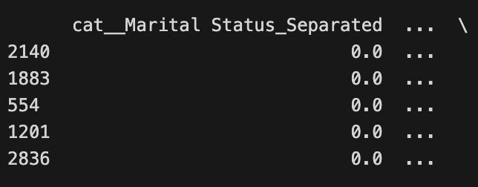
Categorical Feature Analysis
01
Insights from Categorical Features
02
Predictive Value of Categorical Data
"Marital Status," "T Stage," and "N Stage" show varying proportions of "Alive" vs. "Dead"; categorical variables are of particular interest as they possess real predictive value.
Confirms the importance of including these features in the predictive model; inclusion assists with overall model performance.

Slide 11
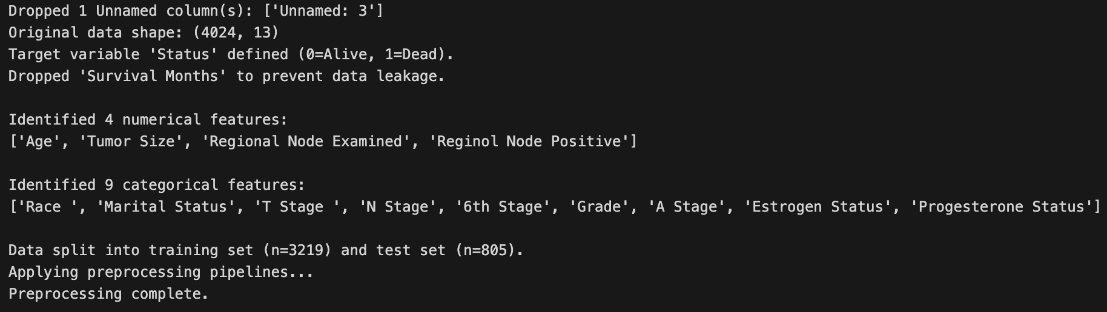
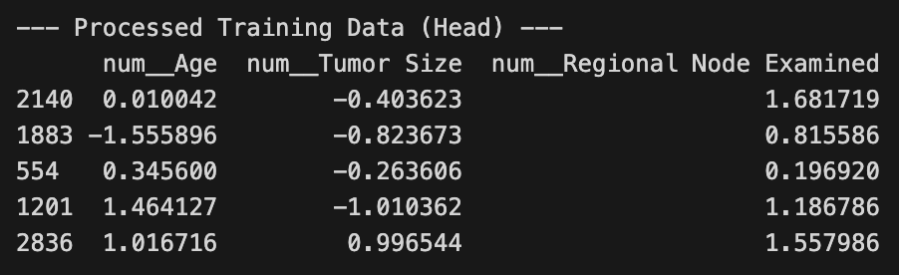
03 Data Preprocessing
The Preprocessing Strategy
Goal of the Pipeline
To create a single, automated, and robust process; address missing values, different data types, and scaling issues.
Tools and Techniques
Using scikit-learn's ColumnTransformer and Pipeline objects; ColumnTransformer and Pipeline prevent data leakage.

Slide 12
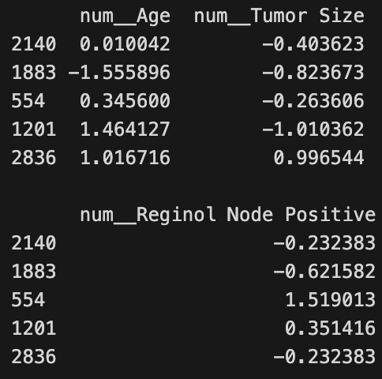
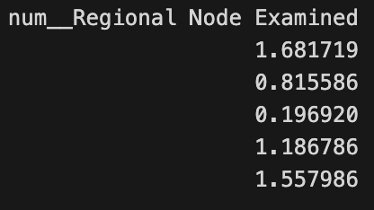
Parallel Pipelines
Numerical Data Pipeline
Imputation of missing values using the median; imputation is chosen over mean because the median is more robust with outlier removal.
Scaling with StandardScaler
Scaling all features using StandardScaler; ensures features like "Age" don't overpower features like "Tumor Size."

Slide 13
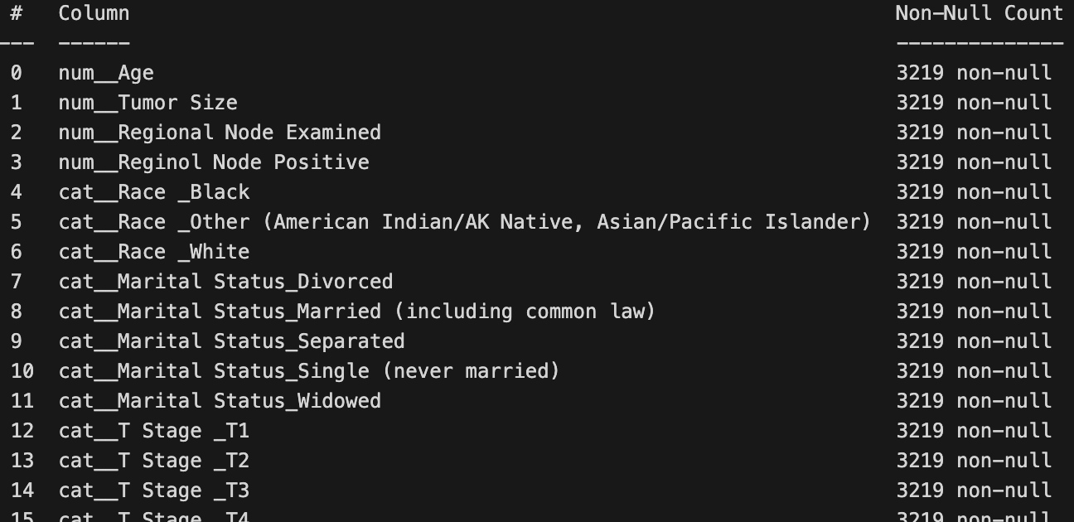
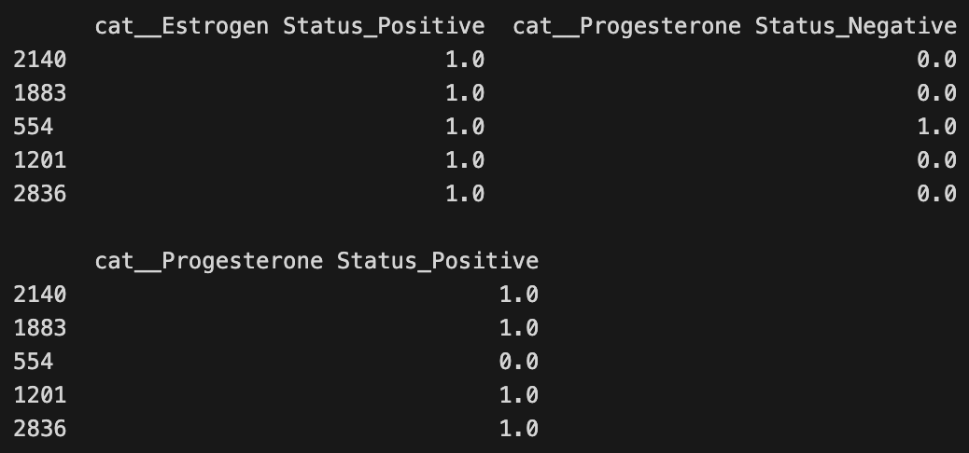
Categorical Data Pipeline
One-Hot Encoding
Imputation of Missing Categories
Converting text into a binary vector; prevents the model from incorrectly learning relationships between categories such as “Married” and “Single.”
Imputation using the mode (most frequent value); ensures that missing values do not influence outcomes.

Slide 14
Final Processed Data & Handoff
01
02
03
Train-Test Split
Ensuring No Data Leakage
Results of Preprocessing
Performing train-test split before any preprocessing; fitting preprocessor on training data only.
Using the transform method on the test set; avoiding information leakage or statistical bias from the test set leaking into the training process.
Clean, entirely numerical data, expanded from 16 features to over 40; data is now ready for model building and evaluation.

Slide 15
04 Initial Model Training
Initial Model Results - The Challenge
Trained 7 baseline models (Logistic Regression, k-NN, SVM, Naive Bayes, Decision Tree, random forest, and AdaBoost)
Dataset: 4,024 samples, 13 features (34 after one-hot encoding)
Performance Summary:
Accuracy: 77-85% (high)
Recall (Dead class): Only 11-15% (very low)
Problem identified: Class Imbalance
Alive: ~84% vs Dead: ~16% (5.5:1 ratio)
Key insight: High accuracy is misleading—models predict everyone as "Alive" to get 85% accuracy, which is useless for identifying at-risk patients.

Slide 16
Model Improvement Strategy
Three Experiments:
Baseline Models: 4 key models (Logistic Regression, Random Forest, AdaBoost, SVM)
Purpose: Establish baseline for comparison
Hyperparameter Tuning (Random Forest):
GridSearchCV with 3-fold cross-validation
Tuned: n_estimators, max_depth, min_samples_leaf
Key: Added class_weight='balanced' to address imbalance
Stacking Classifier:
Ensemble: Tuned RF + AdaBoost + Balanced SVM
Meta-learner: Logistic Regression

Slide 17
Model Results
Model | Accuracy | Recall (Dead) | F1-Score (Dead) | ROC-AUC
Random Forest (Tuned) | 79.01% | 44.72% | 39.43% | 0.7262
Random Forest (Baseline) | 84.47% | 14.63% | 22.36% | 0.6860
Logistic Regression | 85.34% | 13.01% | 21.33% | 0.7345
AdaBoost | 85.34% | 11.38% | 19.18% | 0.7356
SVM | 85.47% | 10.57% | 18.18% | 0.6700

Slide 18
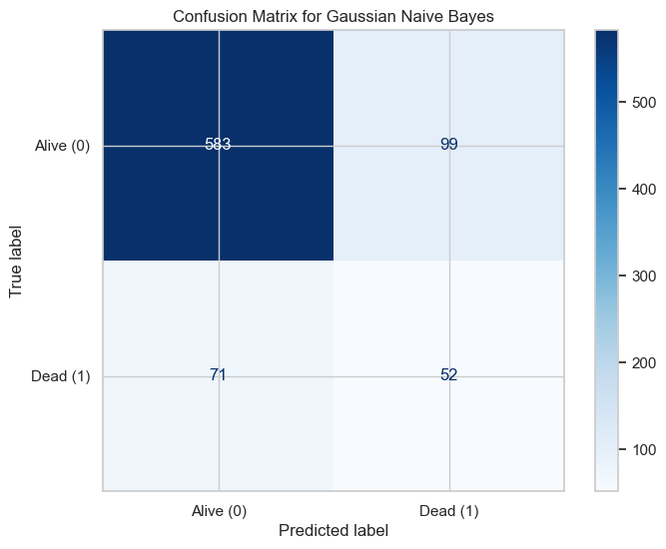
Model Results
Key Improvement:
Baseline RF Recall: 14.63% → Tuned RF Recall: 44.72%
3.06x improvement in identifying at-risk patients
Trade-off: Accuracy slightly lower (79% vs 85%), but this prioritizes catching deaths
Best Hyperparameters Found:
n_estimators: 100
max_depth: 10
min_samples_leaf: 4
class_weight: 'balanced' ← Critical for handling class imbalance
Visual recommendations:
Bar chart comparing Recall across models
Confusion matrix for Tuned Random Forest
Highlight the 3x improvement visually

Slide 19
Key Learnings & Next Steps
Key Takeaways:
Class imbalance is a critical challenge in medical datasets
Hyperparameter tuning with class balancing dramatically improves recall
Feature preprocessing (one-hot encoding) was essential
Tuned Random Forest provides solid foundation
Future Plans:
Advanced imbalance handling: SMOTE, ADASYN
Model refinement: XGBoost, LightGBM, advanced ensembles
Better evaluation: Precision-Recall AUC, cost-sensitive metrics
Model interpretability: SHAP values, feature importance
Goal: Achieve Recall > 50% for minority class

Slide 20
Conclusion
Summary:
Proper preprocessing + class balancing + hyperparameter tuning = significantly improved model
Recall improved from 15% to 44.7% (3x improvement)
Foundation set for further improvements
Next Steps:
Continue model refinement
Focus on interpretability for clinical use
Target: Recall > 50% in final deliverable

